Slide 1
SALES FORECASTING ACROSS MULTIPLE RETAIL STORES
Next Hikes IT Solutions
Rossmann Pharmaceuticals Project
Prepared by: Upasna Agrawal

Slide 2
DATA AND FEATURES
Key Features:
Store: Unique store ID
Sales: Daily revenue (target)
Customers: Number of customers per day
Open: Store status (0 = closed, 1 = open)
State Holiday: Public holidays affecting sales
School Holiday: School closures affecting traffic
Promo: Promotional campaigns impact
Competition Distance: Distance to nearest competitor
Assortment: Store product range (basic, extra, extended)

Slide 3
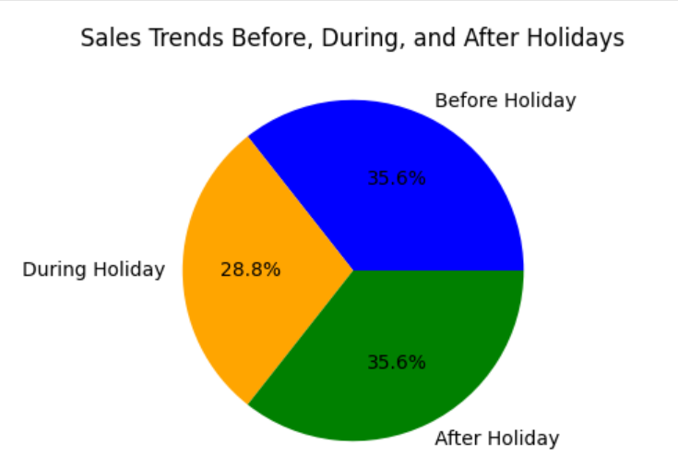
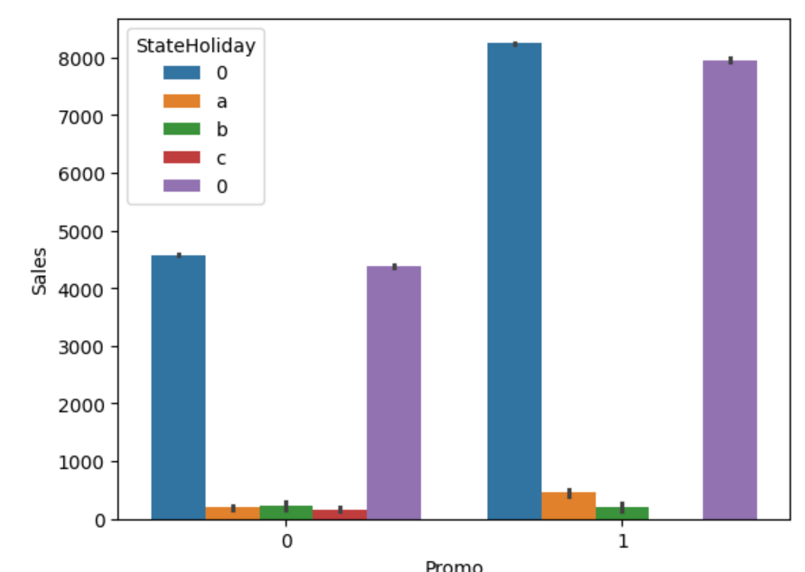
EXPLORATORY DATA ANALYSIS (EDA)
Exploring sales trends and customer behavior:
Distribution of promotions across training/test sets.
Sales behavior before, during, and after holidays
Seasonal effects (Christmas, Easter, etc.)
Correlation between sales and customer count

Slide 4
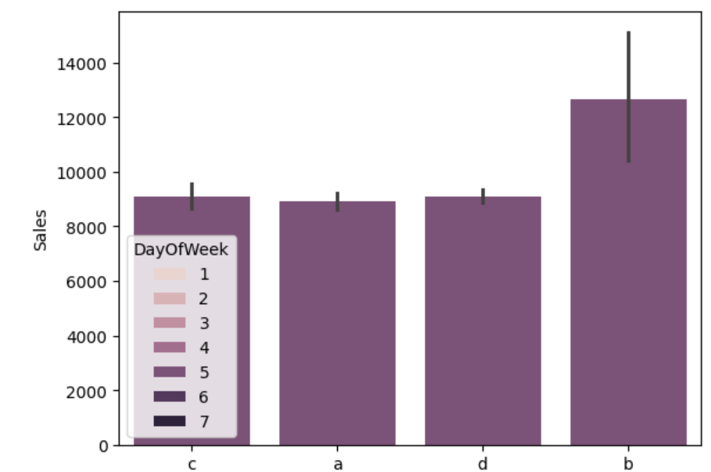
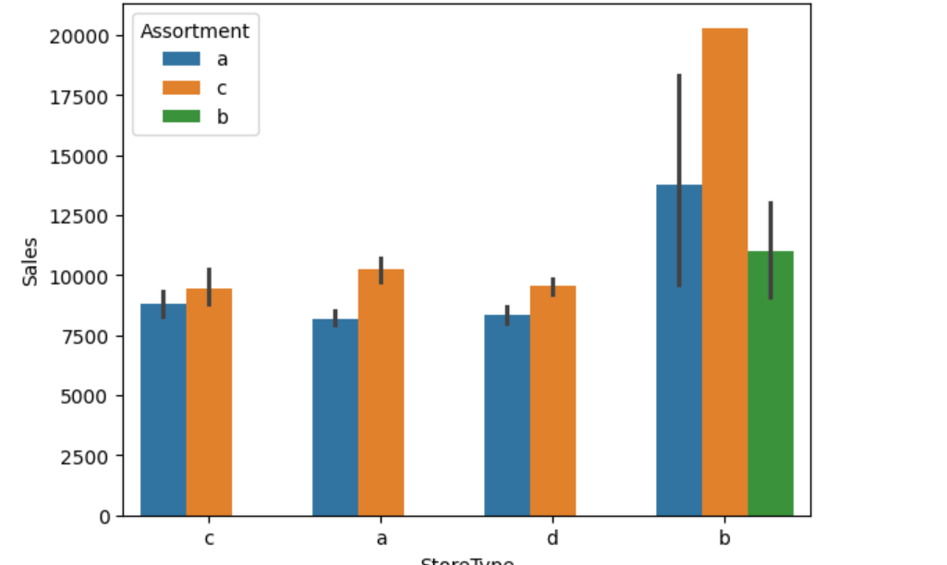
EDA INSIGHTS
Key Insights:
- Promotions increase customer count & sales
- Holiday sales spikes observed (Christmas, Easter)
- Store location & competition impact performance
- Assortment type affects product demand

Slide 5
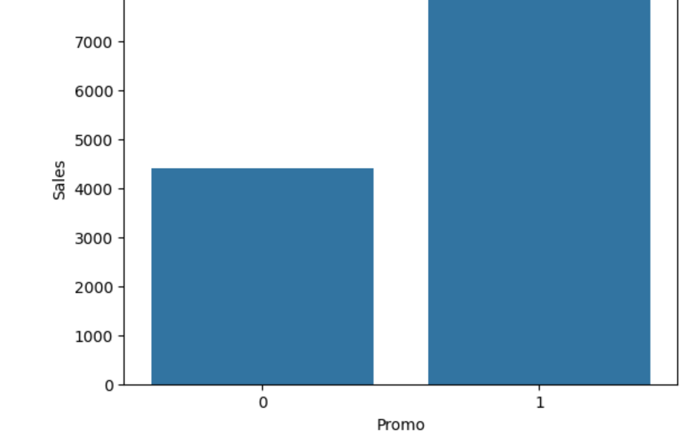
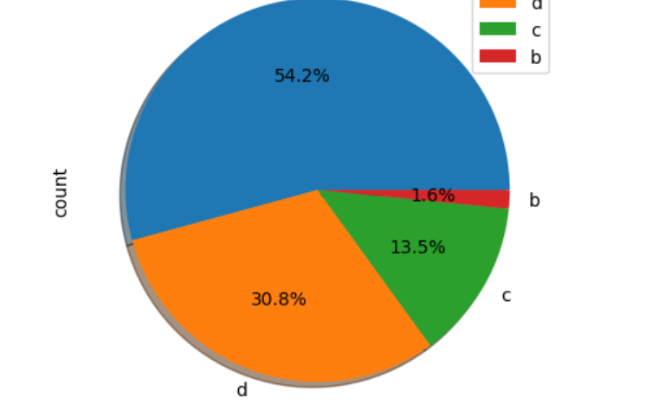
IMPACT OF PROMOTIONS & HOLIDAYS
Findings:
Promos attract more customers but may reduce per-customer spend.
Some stores benefit more from promotions than others.
Sales fluctuate significantly around holidays.
Distance to competitors influences customer traffic.

Slide 6
CORRELATION ANALYSIS
Strong correlation between Sales & Customers (0.89)
Sales influenced by Promotions (0.45)
Negative impact of State Holidays on Sales (-0.23)
Weekly seasonality observed.
Promotions and school holidays impact sales, but promotions are more frequent than school holidays.
The dataset is right-skewed with a large max value (41,551).

Slide 7
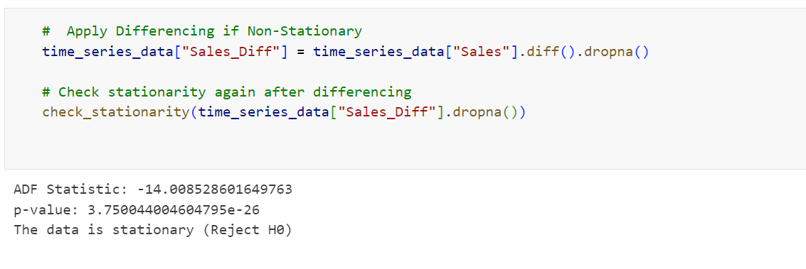
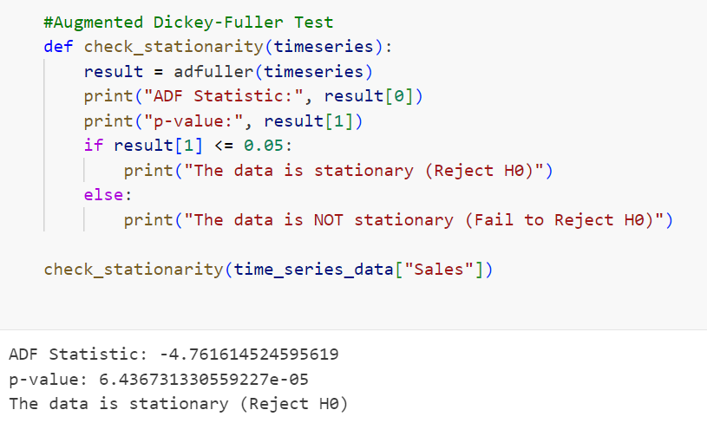
TIME SERIES ANALYSIS
Time series data used for forecasting.
finding time Series Data is Stationary or not using Augmented Dickey-Fuller test.
Significant spikes at lags 7, 14, and 28 – These suggest a weekly seasonality to the autocorrelation (ACF) plot.

Slide 8
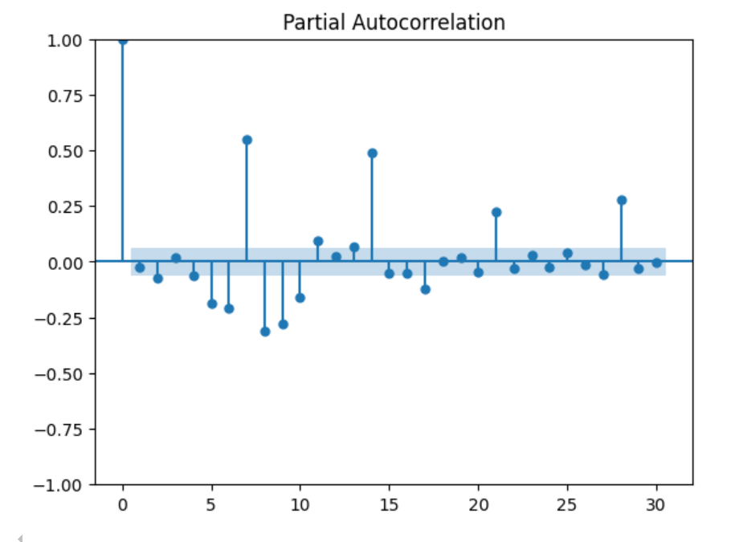
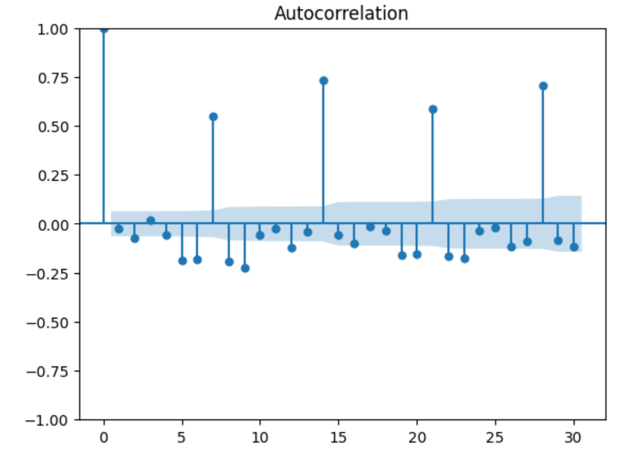
TIME SERIES ANALYSIS
In autocorrelation plot, which helps analyze how a time series (likely sales data) is related to its past values. Lag 0 is always 1 – The correlation of a time series with itself is always 1.
In Partial Autocorrelation Function (PACF) plot, which helps determine the direct relationship between a time series and its past values while removing the effects of intermediate lags.

Slide 9
LSTM SALES PREDICTION
Used LSTM for forecasting.
Model captures general trends but struggles with extreme peaks.
Skills Gained:
Data processing with Pandas & NumPy
Visualization with Matplotlib
Model building with Scikit-Learn
Deep Learning with TensorFlow.
Deployment using Streamlit

Slide 10
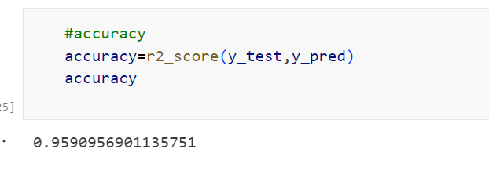
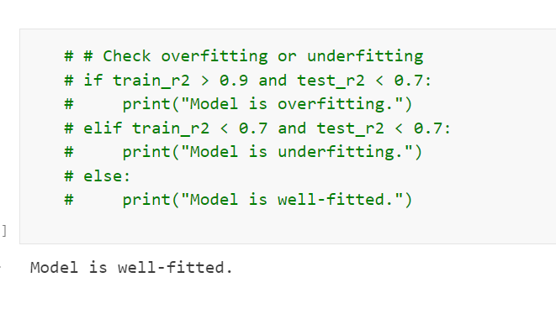
MACHINE LEARNING APPROACH
Data Preprocessing: Handling missing values & feature engineering
- Feature Engineering: Extracting date-based features
- Model Selection: Tree-based models (Random Forest, XGBoost)

Slide 11
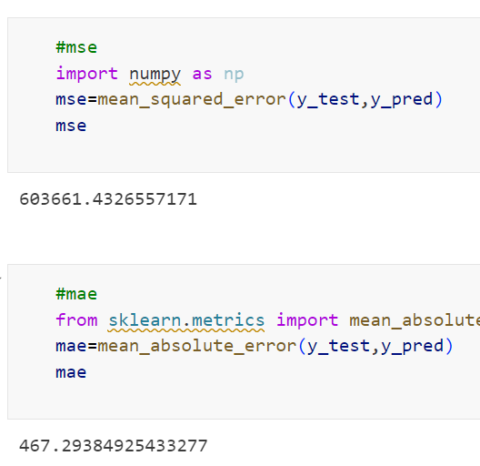
ML MODEL IMPLEMENTATION
Steps:
- Convert categorical variables to numeric columns.
- Feature scaling (Standard Scaler)
- Train-test split and check the shape of them .
- Model evaluation using RMSE & R²

Slide 12
MODEL IMPROVEMENT SUGGESTIONS
Include promotions, holidays as additional features
Try hybrid models (LSTM + XGBoost)
Tune LSTM hyperparameters for better accuracy
Normalize data to improve stability

Slide 13
CHALLENGES & IMPROVEMENTS
Challenges:
- Data quality & missing values
- Overfitting in ML models
- Scaling deep learning models
Improvements:
-Use ensemble models
- Implement real-time predictions

Slide 14
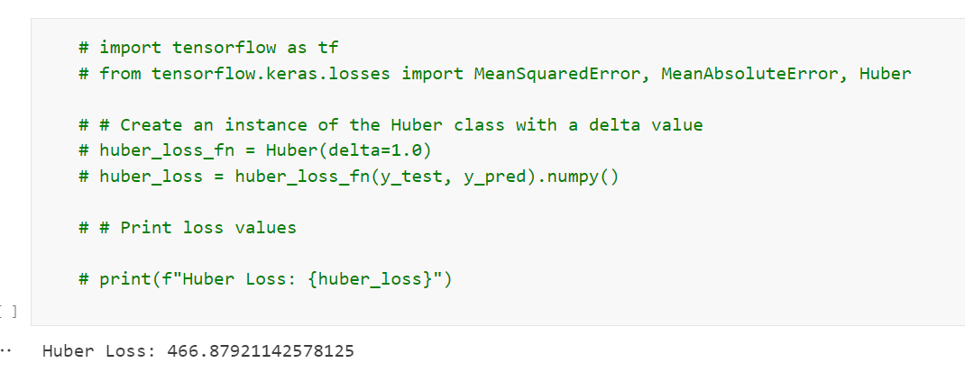
LOSS FUNCTION & POST-PREDICTION ANALYSIS
Choosing a loss function:
- RMSE: Penalizes large errors
- MAE: More robust to outliers
- Post-prediction analysis:
- Feature importance analysis
- Confidence intervals for predictions

Slide 15
CONCLUSION
Summary:
- Built an end-to-end sales forecasting system
- Used ML & DL techniques for predictions
- Deployed a model in local host as well.
Checking actual vs. predicted sales using an LSTM (Long Short-Term Memory) model, a type of neural network designed for time series forecasting.
Transform the time series data into supervised learning data by creating a new y(target) column.

